Slide 1
Git commands
Shubhra Garg

Slide 2
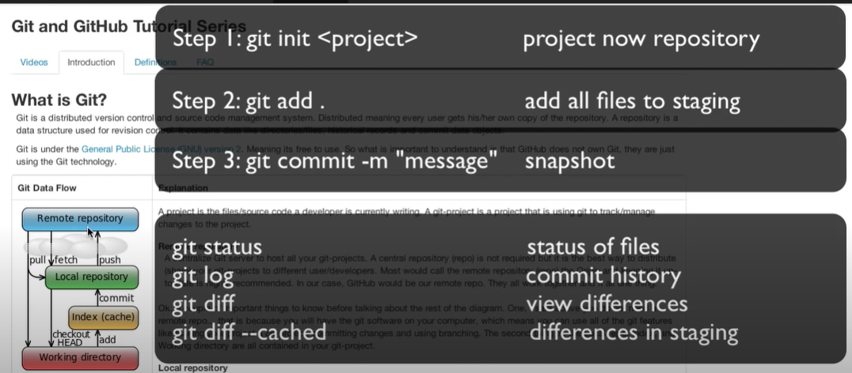

Slide 3
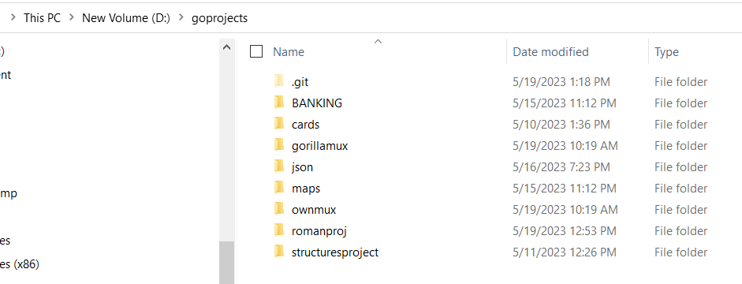
All the golang projects

Slide 4
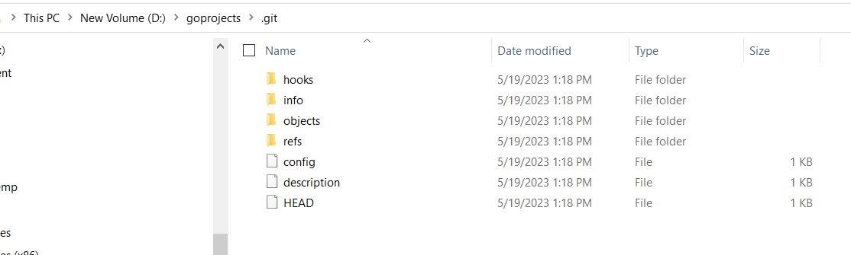
.git file

Slide 5


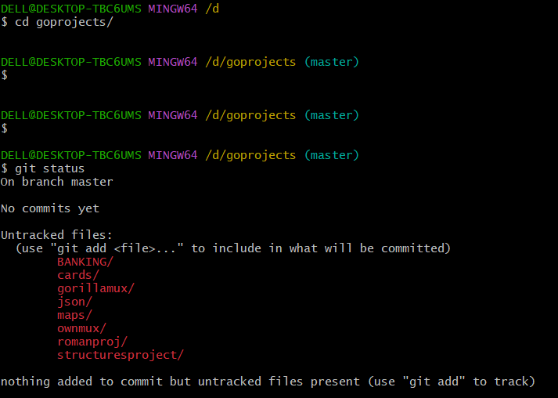
Git command to add the projects to github

Slide 6
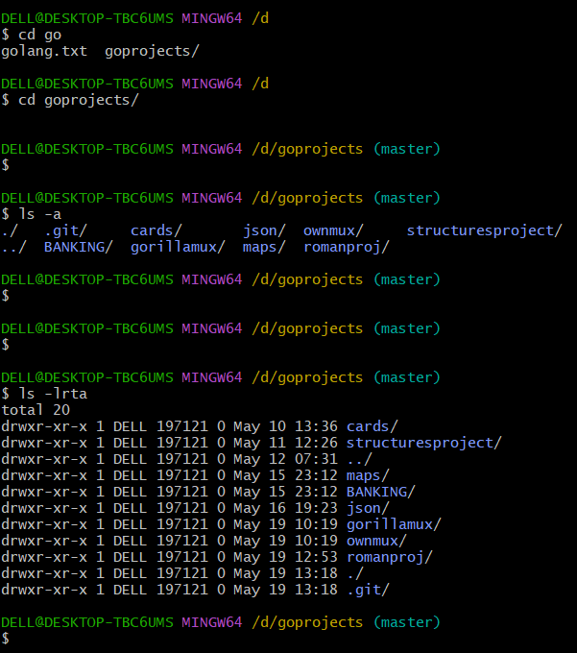
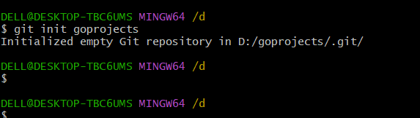
Git init command

Slide 7
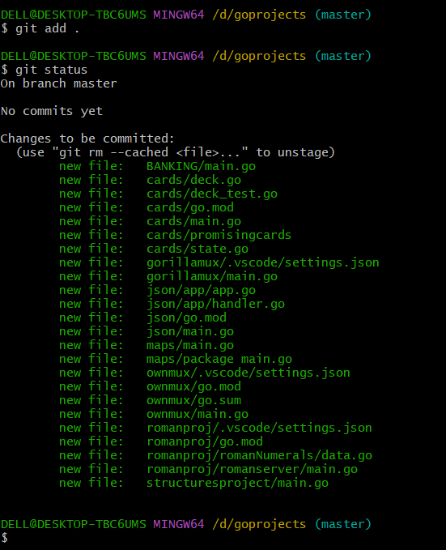
Git add command and git status command

Slide 8
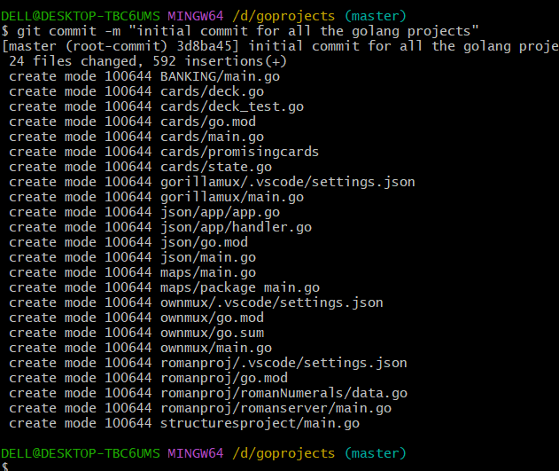
Git commit command

Slide 9
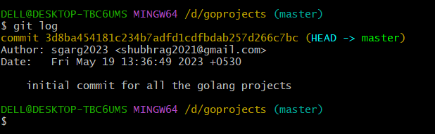
Git log command

Slide 10
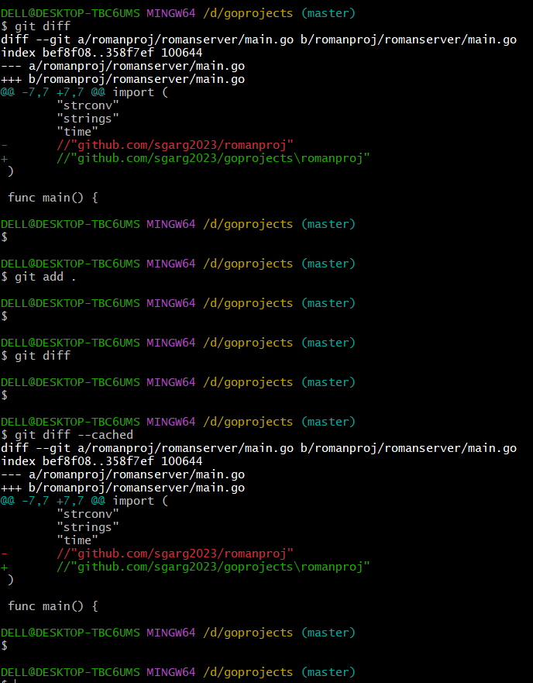
How Git diff and git diff –cached in staging area works
To come out of the terminal
Shift +ZZ

Slide 11
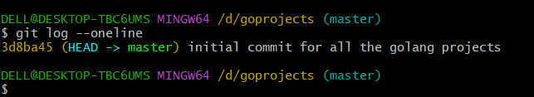
To check all the commits done in oneline

Slide 12
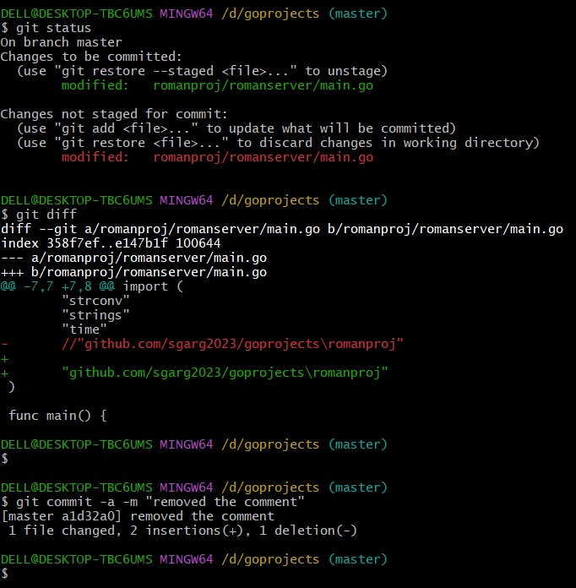
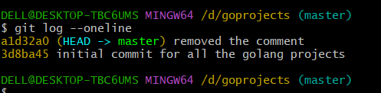
Shortcut for commit, instead of git add

Slide 13
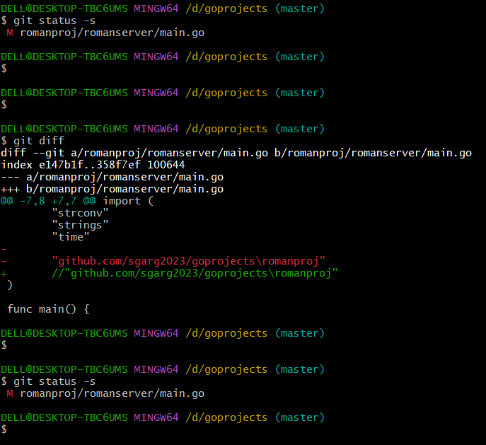
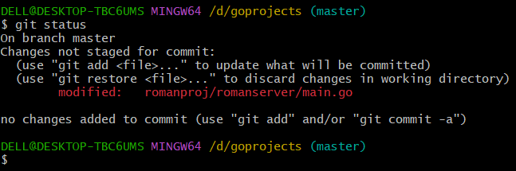
Git status –s command usage

Slide 14
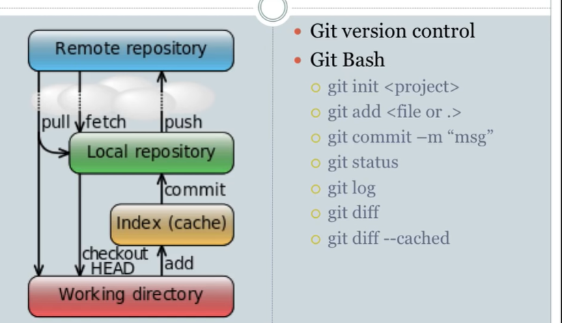

Slide 15
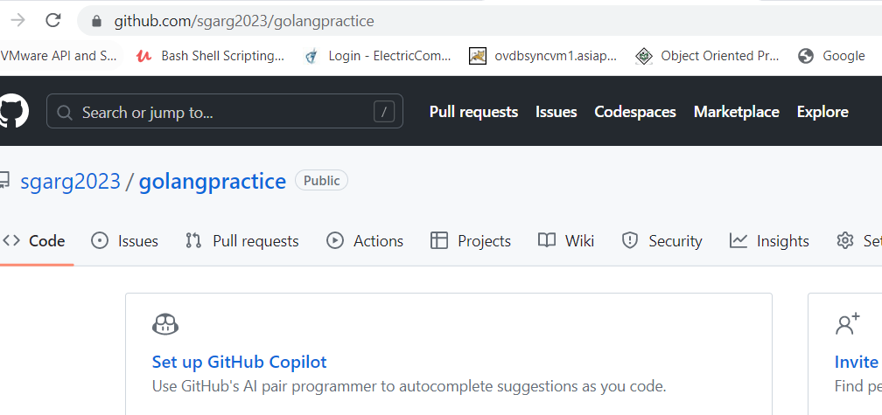
Create a new repository on github

Slide 16
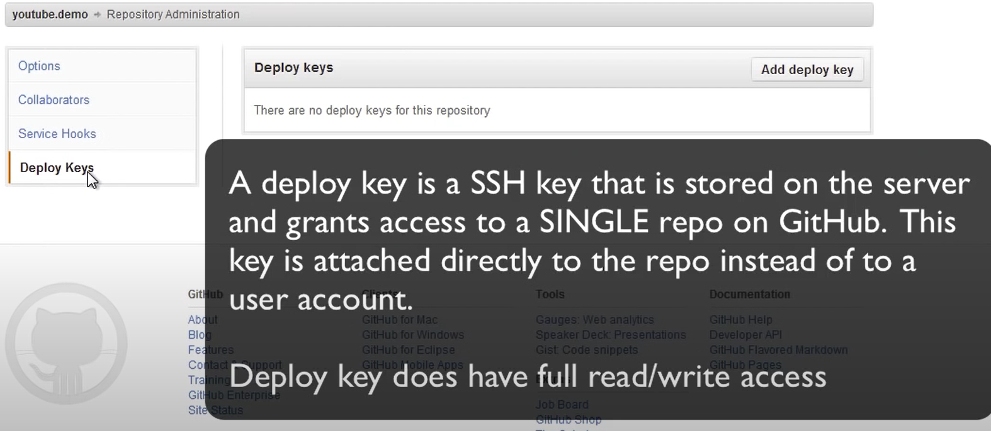
Note on deploy keys

Slide 17
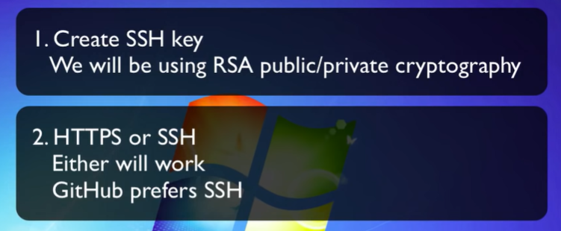
To establish connection between git bash and github

Slide 18
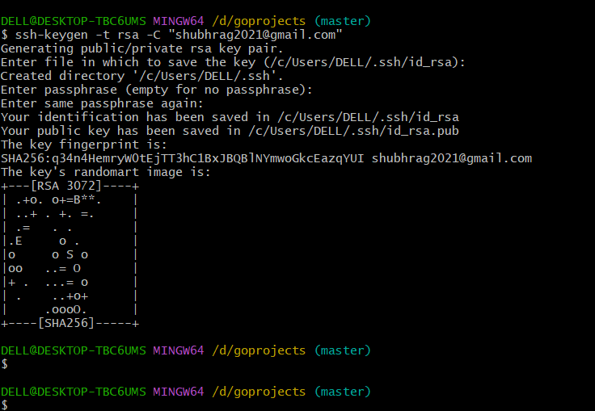
How to create ssh keys

Slide 19
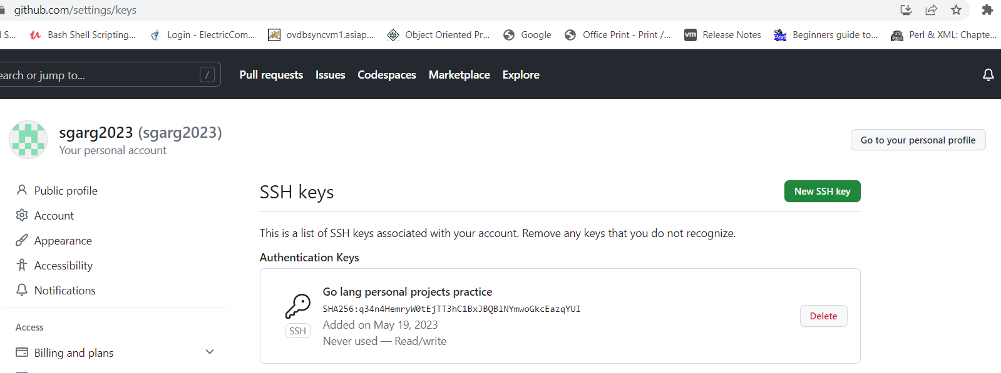
How to add public ssh key to github
ssh-keygen -t rsa -C "shubhrag2021@gmail.com"
to (/c/Users/DELL/.ssh/id_rsa)
Copy the Public SSH key
Go to account settings on github and add the public ssh key and the password

Slide 20
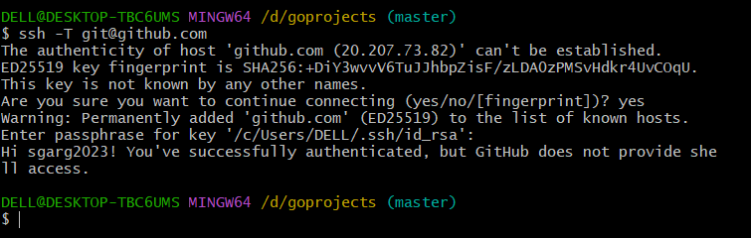
Authentication over gitbash

Slide 21
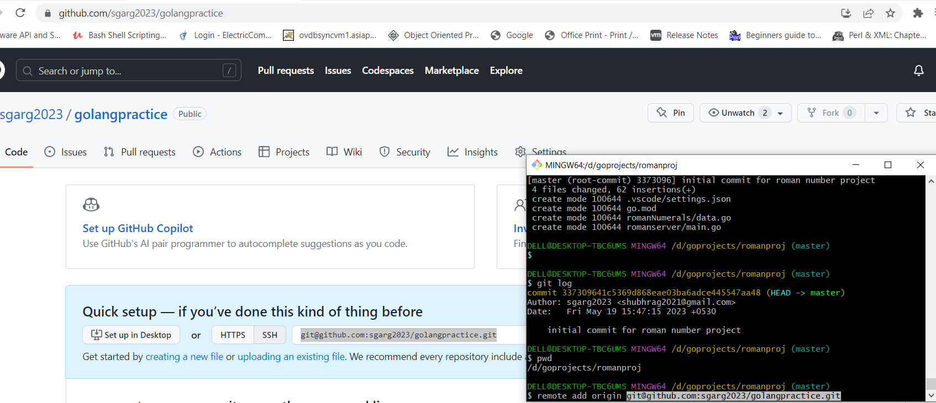
How to add origin from github ssh field to Git bash
Command : git remote add origin “name of remote repository”
Git remote add origin git@github.com:sgarg2023/golangpractice.git

Slide 22
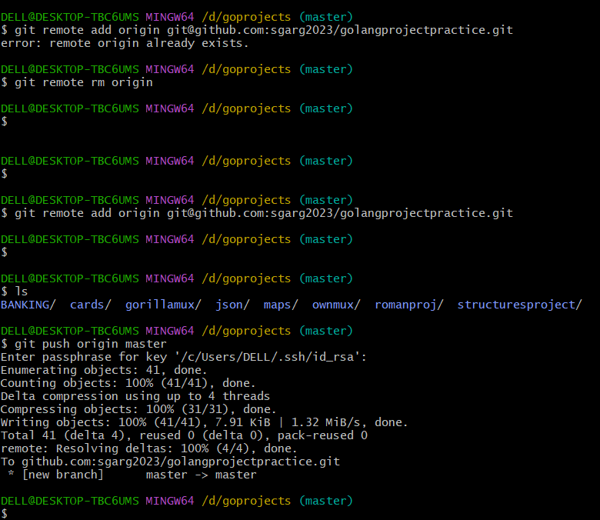
How to delete previous origin and add new origin

Slide 23
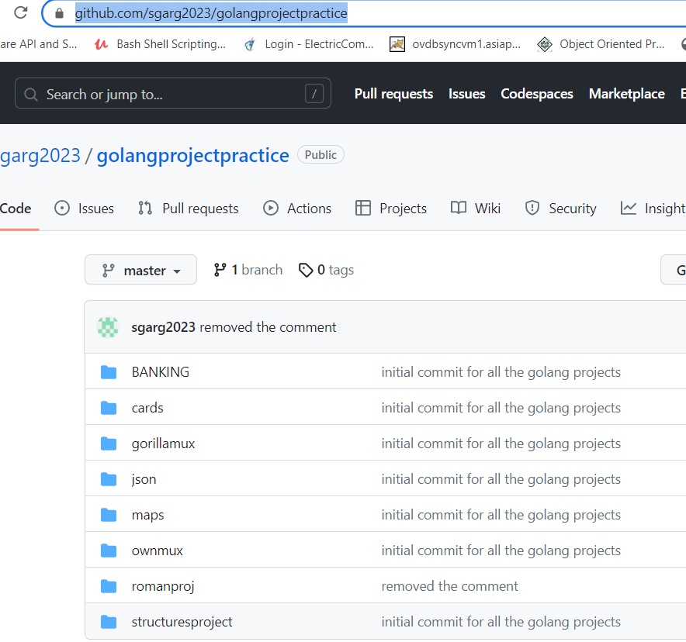
All Golang projects got added to Github! Hurray!
Link : https://github.com/sgarg2023/golangprojectpractice

